Slide 1

Sass - Clone Instagram
Enrique Hidalgo

Slide 2
What is SASS? What does SASS stand for?
SCSS is a preprocessor which lets you use features that aren’t a part of the wider CSS standard yet, and provides better workflows for maintaining your stylesheets.
With SCSS preprocessor, you can reduce the amount of times you repeat yourself and ensure you’re writing clean, maintainable code for the future.
Scss can take css code and work.
SCSS is fully compatible with the syntax of CSS, while still supporting the full power of Sass.
Scss is an extension of the syntax of CSS. This means that every valid CSS stylesheet is a valid SCSS file with the same meaning. In addition, SCSS understands most CSS hacks and vendor-specific syntax, such as IE's old filtersyntax. This syntax is enhanced with the Sass features described below. Files using this syntax have the .scss extension.

Slide 3
What is a CSS pre-processor?
CSS preprocessors are scripting languages that extend the default capabilities of CSS. They enable us to use logic in our CSS code, such as variables, nesting, inheritance, mixins, functions, and mathematical operations

Slide 4
What does a pre-processor have to do with SASS?
Sass (Syntactically Awesome Style Sheets) is a powerful CSS preprocessor scripting language that helps you to work on your style sheet much faster than ever. Sass allows you to use features such as variables, nestings, modules, etc. that don't exist in CSS. You can then compile it into a normal CSS file.

Slide 5
Why use SASS?
There's a lot of reasons on why we should use SASS. Some of the reasons are variables, which help make things easier to change without having to change every single one of them. It also allows you to write cleaner and maintainable code than you could with vanilla CSS.

Slide 6
SASS has disadvantages? Which are?
The developer must have enough time to learn new features present in this preprocessor before using it.
Using Sass may cause losing benefits of browser's built-in element inspector.
Code has to be compiled.
Difficult Troubleshooting.

Slide 7
What is a SASS Variable?
Sass variables are used to store information that can be reused throughout the stylesheet when you need. You can store things like colors, font stacks, or any CSS value according to your future reusability. The $ symbol is used to make something a variable.

Slide 8
Explain the SASS variables property with an example.
$myFont: Helvetica, sans-serif;
$myColor: red;
$myFontSize: 18px;
$myWidth: 680px;
body {
font-family: $myFont;
font-size: $myFontSize;
color: $myColor;
}
#container {
width: $myWidth;
}
Sass variables are simple: you assign a value to a name that begins with $ , and then you can refer to that name instead of the value itself.

Slide 9
What is a mixin? Why is it important? Give an example
A mixin lets you make groups of CSS declarations that you want to reuse throughout your site.
To create a mixin you use the @mixin directive and give it a name. We've named our mixin transform. We're also using the variable $property inside the parentheses so we can pass in a transform of whatever we want. After you create your mixin, you can then use it as a CSS declaration starting with @include followed by the name of the mixin.
//SCSS
@mixin transform($property) {
-webkit-transform: $property;
-ms-transform: $property;
transform: $property;
}
.box { @include transform(rotate(30deg)); }
//CSS
.box {
-webkit-transform: rotate(30deg);
-ms-transform: rotate(30deg);
transform: rotate(30deg);
}

Slide 10
What is SCSS?
SCSS is a special type of file for SASS , a program written in Ruby that assembles CSS style sheets for a browser, and for information, SASS adds lots of additional functionality to CSS like variables, nesting and more which can make writing CSS easier and faster.
//SCSS
@mixin transform($property) {
-webkit-transform: $property;
-ms-transform: $property;
transform: $property;
}
.box { @include transform(rotate(30deg)); }

Slide 11
What is the difference between .scss and .sass syntax.
Let’s list down the main difference between SASS and SCSS.
SASS is used when we need an original syntax, code syntax is not required for SCSS.
SASS follows strict indentation, SCSS has no strict indentation.
SASS has a loose syntax with white space and no semicolons, the SCSS resembles more to CSS style and use of semicolons and braces are mandatory.
SASS file extension is .sass and SCSS file extension is .scss.
SASS has more developer community and support than SCSS.

Slide 12
In which cases would we use SCSS? And in which cases would we use SASS?
SASS is used when we need an original syntax, code syntax is not required for SCSS. SASS follows strict indentation, SCSS has no strict indentation. SASS has a loose syntax with white space and no semicolons, the SCSS resembles more to CSS style and use of semicolons and braces are mandatory.

Slide 13
Explain how traditional CSS and Preprocessed CSS workflows are different.

Slide 14
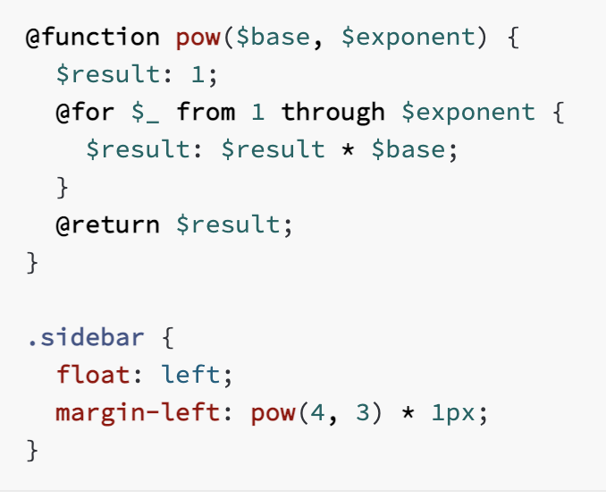
Can we create functions with SASS? If it is true, give an example.
Functions are defined using the @function at-rule, which is written @function <name>(<arguments...>) { ... }. A function’s name can be any Sass identifier. It can only contain universal statements, as well as the @return at-rule which indicates the value to use as the result of the function call. Functions are called using the normal CSS function syntax.

Slide 15
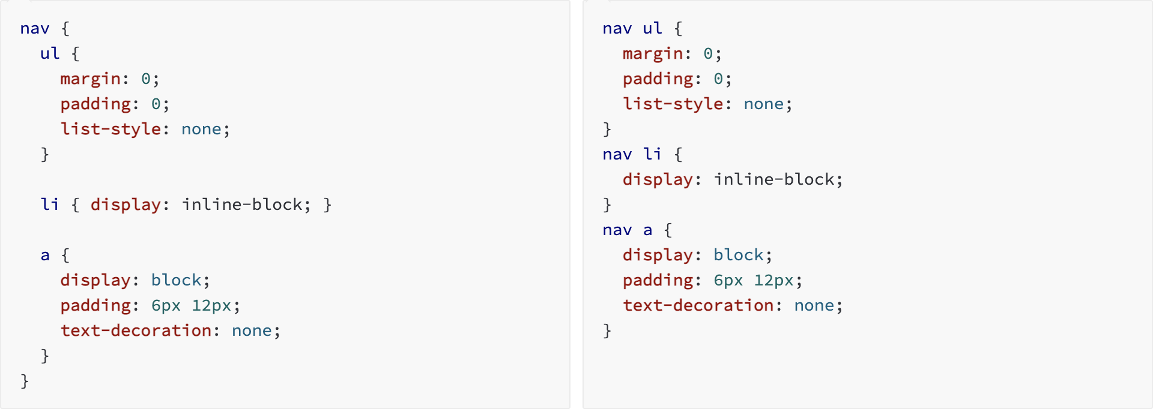
What is nesting? Is it useful? Give an example of nesting
When writing HTML you've probably noticed that it has a clear nested and visual hierarchy. CSS, on the other hand, doesn't.
Sass will let you nest your CSS selectors in a way that follows the same visual hierarchy of your HTML. Be aware that overly nested rules will result in over-qualified CSS that could prove hard to maintain and is generally considered bad practice.

Slide 16
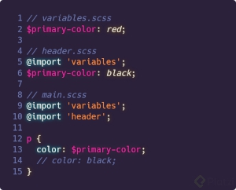
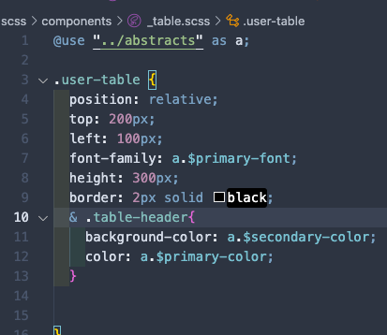
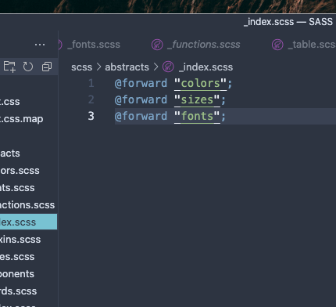
Difference between @use & @import? Give an example
The new @use rule is the replacement for @import which allows other stylesheets to use its variables, functions, and mixins. What makes the @use import different is that the module (file imported using @use ) is only imported once, no matter how many times you reference it in your project.

Slide 17
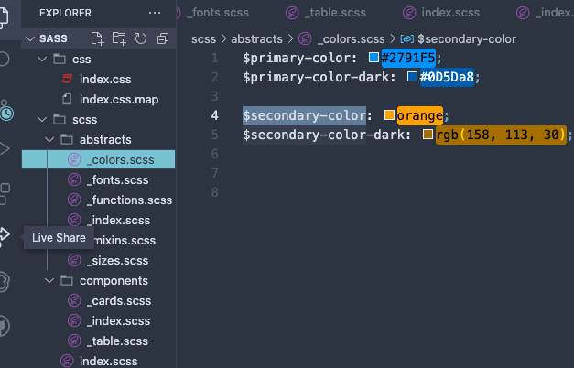
How can we import other CSS/SASS files in SASS? Give an example
First we create different files to organise.
*Important to use underscore to avoid compiling the files we don’t need to compile.

Slide 18
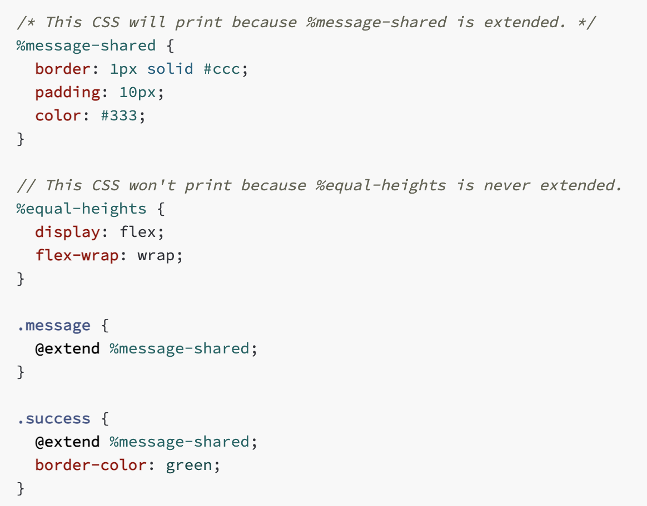
Explain the concept of inheritance in SASS.
Inheritance is the mechanism of basing an object or class upon another object (prototype-based inheritance) or class (class-based inheritance), retaining similar implementation.

Slide 19
Why use @extend? Give an example
This is one of the most useful features of Sass. Using @extend lets you share a set of CSS properties from one selector to another. It helps keep your Sass very DRY. In our example we're going to create a simple series of messaging for errors, warnings and successes using another feature which goes hand in hand with extend, placeholder classes. A placeholder class is a special type of class that only prints when it is extended, and can help keep your compiled CSS neat and clean.

